Slide 1
Doosan Infracore - Portable Power
CONFIDENTIAL
BL2000 BALLOON LIGHT
FALL 2009

Slide 2
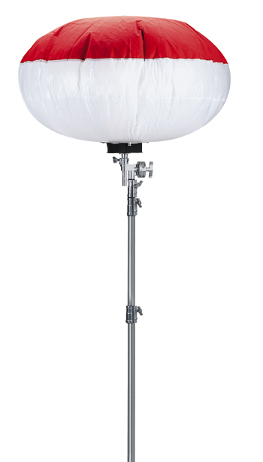
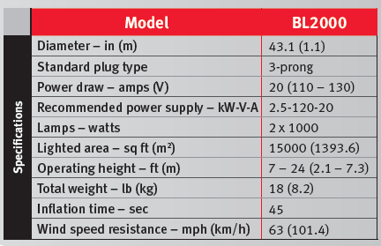
General Specs and Features
BL2000
Balloon Light
2000 Watts of Light

Slide 3
Market
Balloon lights provide efficient, glare-free light for applications such as:
Construction
Disaster Relief
Drilling
Farming/Agriculture
Guard Rail Installation
Landscaping
Mining
Paving
Road Repair / Maintenance
Railroad Repair / Maintenance
A number of State DOT’s are now mandating the use of ‘glare-free’ light on night road construction jobsite. Some include:
Illinois
Pennsylvania….

Slide 4
Benefits
Diffuses glare-free light over a 360° area
Covers 15,000 sq. ft.
Mounts onto any piece of equipment or can be used stand-alone
Mounting it to the equipment means the light moves with the job
Quick, easy set-up
Do not touch halogen bulbs with bare hand
Inflates in less than one minute for instant illumination
Wait five minutes to cool down before storage
Lightweight
Weighs less than 40 lbs
Packs into a container small enough to keep in a car
Has a wind speed resistance of over 60 MPH

Slide 5
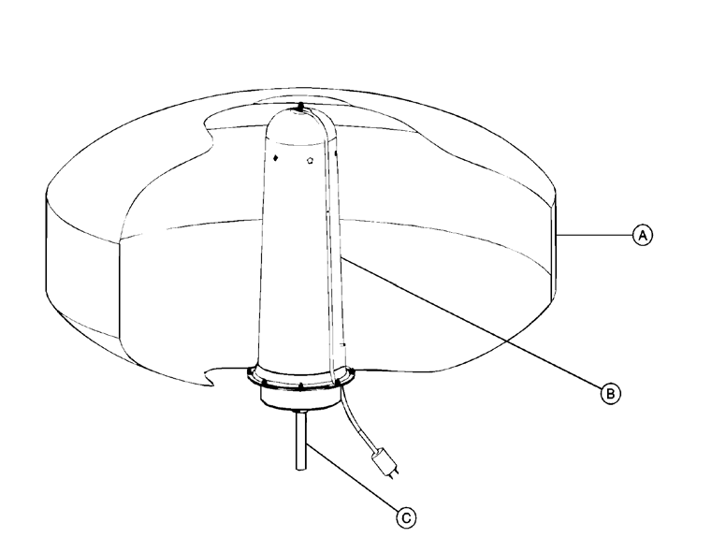
Components
Three section diffusion envelope, Rip-Stop Nylon with Polyurethane Coating
Internal reflective dome
Protective impact resistant polycarbonate shroud
(2) 1000W Halogen bulbs
Powered by standard 110V / 20A
Standard 3-prong plug (can be wired directly to equipment)
Fan assembly inflates balloon
Connection pole – attaches to the mounting options sold separately through aftermarket as an accessory

Slide 6
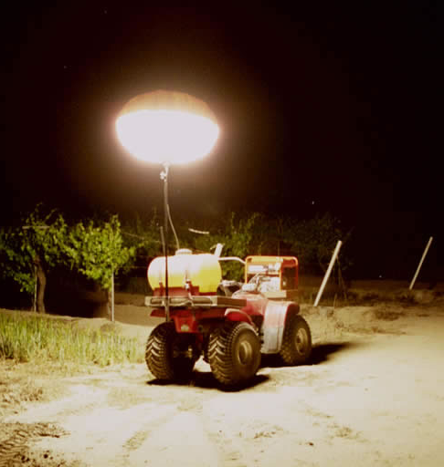
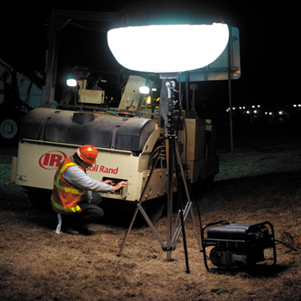
Optional Stands
Pole Mount
7 to 15 ft extension
Mounts to any equipment using locally sourced hardware
U-Brackets, welding, etc.
Hitch Mount
7 to 15 ft extension
Mounts directly to a vehicle’s hitch receiver
Tripod Stand
7 to 24 ft extension
Stand-alone applications
Pole Mount
Hitch Mount
Tripod Stand

Slide 7
Item Numbers
Balloon Light - Order from DIPP Completes:
Model: BL2000
Part Number: #22832596
FREIGHT INFORMATION: Flat Freight Rate ‐ $60 per unit
*Six (6) or more of any model combination will receive free freight to a single "ship to" address.
*Factory reserves the right to change flat rate policy at any time. Only applicable for shipments to the lower 48 states.
Optional Mounting Systems – Sold Separately - Order from DIPP Aftermarket:
Model Option Part Number Height
Pole Mount #2236798 1 7-15 ft extension.
Truck Mount #22367973 7-15 ft extension.
Tripod Stand #22407555 7 to 19 ft extension.
Tripod Stand #22407548 7 to 24 ft extension.
FREIGHT INFORMATION: See parts freight policy

